Slide 1


CREDIT RISK ANALYSIS
A Business Case for New Market Entry
Vinit Solanki
Click here for watch video

Slide 2


Overview of the Credit Risk Dataset
Dataset Summary:
Contains financial and personal attributes of individuals applying for loans.
Used for analyzing loan performance, risk factors, and borrower characteristics.
Key Features:
Demographics: person_age, person_income, person_home_ownership, person_emp_length
Loan Attributes: loan_amnt, loan_grade, loan_int_rate, loan_percent_income, loan_intent
Credit Risk Indicators: loan_status (0: Non-default, 1: Default), cb_person_default_on_file
Other Metrics: cb_preson_cred_hist_length (credit history in years)
Analysis Goals:
Identify factors contributing to loan default
Explore how income, employment, and loan intent influence risk
Provide actionable insights for lending decisions using Power BI

Slide 3
Financial Metrics by Loan Grade
Overview: This analysis presents key financial metrics segmented by loan grade, providing insights into lending risk and borrower behavior.
Key Observations
Grades A to C tend to have lower average loan amounts and lower interest rates, resulting in lower default rates.
Grades D to G show an increasing trend in both interest rates and default rates, indicating higher borrower risk.
A clear correlation is seen between higher interest rates and default likelihood, supporting the use of risk-based pricing models.
Loan amounts tend to increase slightly with riskier grades, amplifying the potential financial exposure.
Findings:
Loan grades A and B reflect lower average interest rates and minimal default occurrences
Higher-risk grades (E to G) demonstrate increased average interest rates and significantly higher default ratios
A direct correlation is observed between interest rate and likelihood of default
DAX Measures
Avg_Loan_Amount = AVERAGE('CreditRisk'[loan_amnt])
Avg_Interest_Rate = AVERAGE('CreditRisk'[loan_int_rate])
Default_Rate =
VAR Total_Loans = COUNT('CreditRisk'[loan_status])
VAR Defaulted_Loans = CALCULATE(COUNT('CreditRisk'[loan_status]), 'CreditRisk'[loan_status] = 1)
RETURN DIVIDE(Defaulted_Loans, Total_Loans, 0)

Slide 4
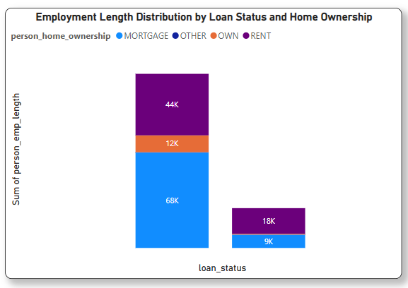
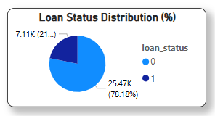
Visualization of Loan Status
Insights:
A large portion of borrowers (78.18%) did not default, while 21.82% did
The MORTGAGE and RENT groups account for the majority of both default and non-default cases
Within the non-default group, borrowers with longer employment length and MORTGAGE status are dominant
RENT group shows a higher concentration of defaults, highlighting financial instability
OWN and OTHER ownership types have minimal defaults, suggesting better financial resilience
Employment length is not conclusive alone, but when paired with home ownership, it reveals clearer default trends
Key Observations:
RENT status is closely linked with higher default rates
MORTGAGE borrowers are present in both groups, but lean towards lower defaults with longer employment
OWN and OTHER categories show strong financial discipline
Combined indicators (employment + ownership) improve risk analysis and segmentation

Slide 5
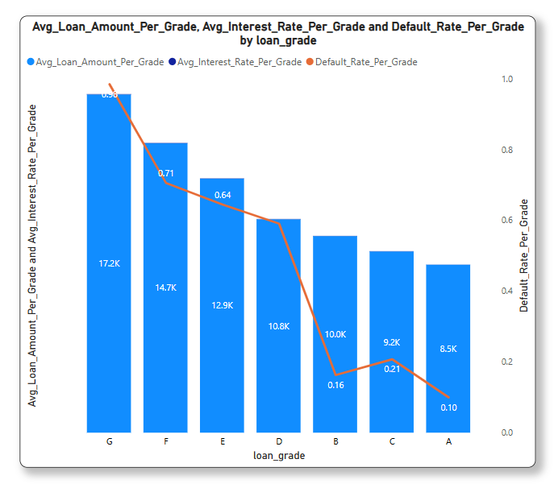
Segmentation Analysis Using Loan Intent
Insights:
Overview This analysis compares average loan amount, average interest rate, and default rate across different loan grades (A to G), offering insight into how creditworthiness affects financial terms and risk levels.
Key Observations
Grade G borrowers have the highest average loan amount (17.2K) and highest interest rate (0.83), paired with a very high default rate.
A clear descending trend is visible from Grade G to A in all three metrics:
Loan amount
Interest rate
Default rate
Grade A borrowers have the lowest loan amount (8.5K) and interest rate (0.10), with the lowest default rate — reflecting the best credit profiles.
Grades B and C offer moderate risk with relatively lower default rates (0.16 and 0.21) compared to lower grades.
The chart indicates a strong positive correlation between interest rates and default rates — higher interest is charged where risk is higher.
Insights
Lenders mitigate risk by increasing interest rates for lower grades, but these borrowers also tend to borrow more.
Loan grade is a critical predictor for default risk and helps in designing lending strategies.
This segmentation supports effective risk-based pricing and credit evaluation.

Slide 6

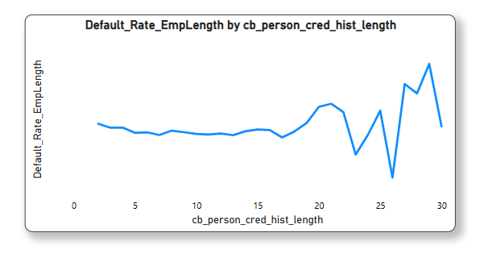
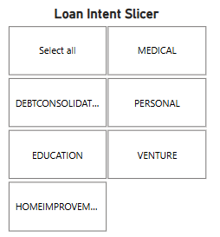
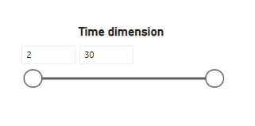
Time Series Analysis
Overview:
This analysis examines how loan default rates vary with the length of a borrower's credit history. Using a time slicer, we observe that default rates remain stable for most ranges but become more volatile after 20 years of credit history.
Insights:
The default rate remains fairly stable for credit history lengths between 2 to 18 years, mostly fluctuating between 0.18 to 0.22.
A noticeable increase in default rates starts after 20 years, with multiple spikes — peaking near 0.42 at 29 years.
This trend suggests that longer credit history doesn't guarantee lower risk; in fact, in some cases, defaults increase — possibly due to aging borrowers or outdated credit behavior patterns.
Key Observations:
Stable default behavior is observed among borrowers with moderate credit history.
High volatility beyond 20 years indicates the importance of reviewing old accounts carefully.
Borrowers with credit history above 25 years may require additional scrutiny or segmentation.

Slide 7
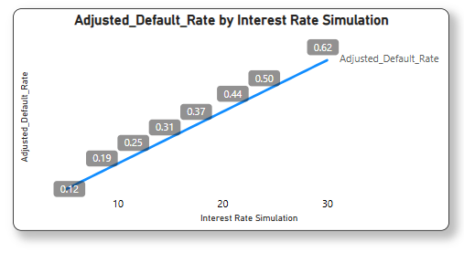
Impact of Interest Rate on Default Rate
Overview
This simulation explores the potential impact of varying interest rates on loan default rates using a What-If Parameter. It models borrower response under different rate scenarios, helping to predict financial risk and lending performance in changing economic conditions.
Insights
There is a clear positive correlation between interest rates and default rates.
As interest rates rise, the adjusted default rate increases steadily.
At lower interest levels (5–10%), default rates remain relatively low (around 12%–19%).
A significant increase in defaults is observed once the interest rate crosses 20%.
At 30% interest, the default rate reaches 62%, indicating a high-risk lending environment.
Key Observations
The default rate increases consistently with each 5% rise in interest rate.
The 20%–25% interest range appears to be a critical tipping point for borrower defaults.
Higher interest loans require stricter risk assessment due to rising default probability.
This simulation is valuable for stress testing, policy formulation, and strategic lending decisions.

Slide 8
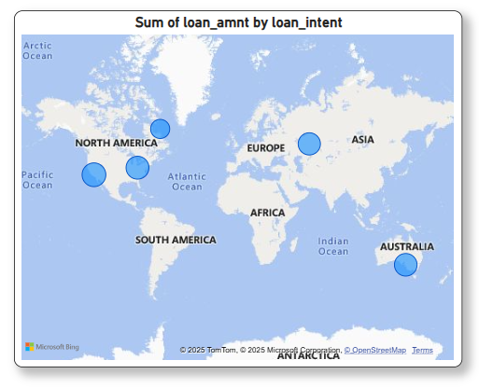
Geographic Data Exploration
Overview
The geographic bubble map visualizes the total loan amount (loan_amnt) across various global regions. Each bubble represents a region, and its size corresponds to the total loan volume, providing a quick understanding of geographic loan distribution.
Insights
North America has the highest total loan amount, indicating a significant borrower base or higher loan amounts issued.
Europe and Australia show moderate loan activity, reflecting stable financial engagement.
Regions like South America, Asia, and the Pacific Islands show lower loan sums, possibly due to smaller datasets or limited lending operations.
Africa and Antarctica appear to have no recorded loan data in this view.
Key Observations
Loan activity is concentrated in developed regions, suggesting a correlation between lending and economic infrastructure.
Lack of data in certain areas could signal untapped markets or restricted access to lending systems.
Bubble map visuals help stakeholders identify high-performing regions and explore underserved markets for expansion or policy development.

Slide 9
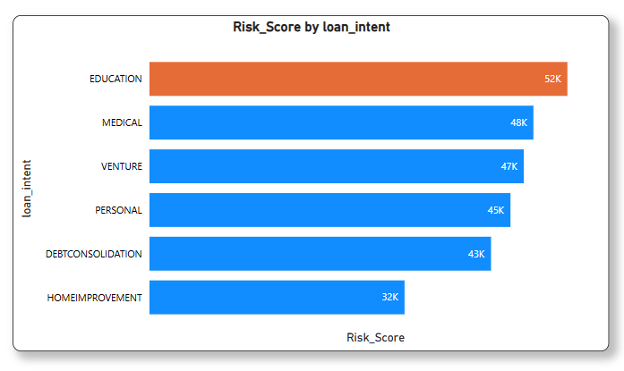
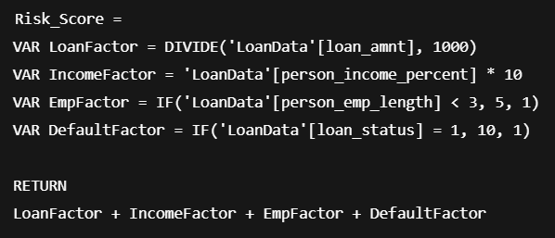
Time Series Analysis
Overview
This visualization shows the Risk Score by different loan intents. The Risk Score is derived using a custom DAX formula that incorporates loan amount, borrower’s income percentage, employment length, and default history to assess the relative risk associated with each loan category.
Insights
Education loans carry the highest risk score (52K), possibly due to larger loan amounts and higher default association.
Medical and Venture loans follow, highlighting financial strain or startup uncertainty as risk factors.
Home Improvement loans show the lowest risk score, indicating more stability or smaller loan sizes.
Key Observations
Higher risk scores are often tied to intentions with long-term returns (e.g., education, venture), suggesting delayed repayment potential.
The inclusion of employment length and default history helps in identifying unstable borrower profiles.
Such scoring models are essential in prioritizing loan approvals, setting interest rates, and minimizing defaults.

Slide 10

Security Features for Sensitive Data
Overview
Row-Level Security (RLS) is implemented to restrict data access for users based on their region or department, ensuring that each user can only view the data relevant to their assigned role. This enhances data privacy, reduces risk of exposure, and maintains compliance.
Implementation Approach
Step 1: Create a Security Table Includes: Username and corresponding Region or Department
Step 2: Define Relationship Link the Security Table to the main data table using Region or Department
Step 3: Configure Role in Power BI Use DAX in Manage Roles:
[Region] = LOOKUPVALUE(Security[Region], Security[Username], USERNAME())
Step 4: Test and Publish
Simulate views with “View as Roles”
Assign users in Power BI Service
Key Observations
Higher risk scores are often tied to intentions with long-term returns (e.g., education, venture), suggesting delayed repayment potential.
The inclusion of employment length and default history helps in identifying unstable borrower profiles.
Such scoring models are essential in prioritizing loan approvals, setting interest rates, and minimizing defaults.

Slide 11
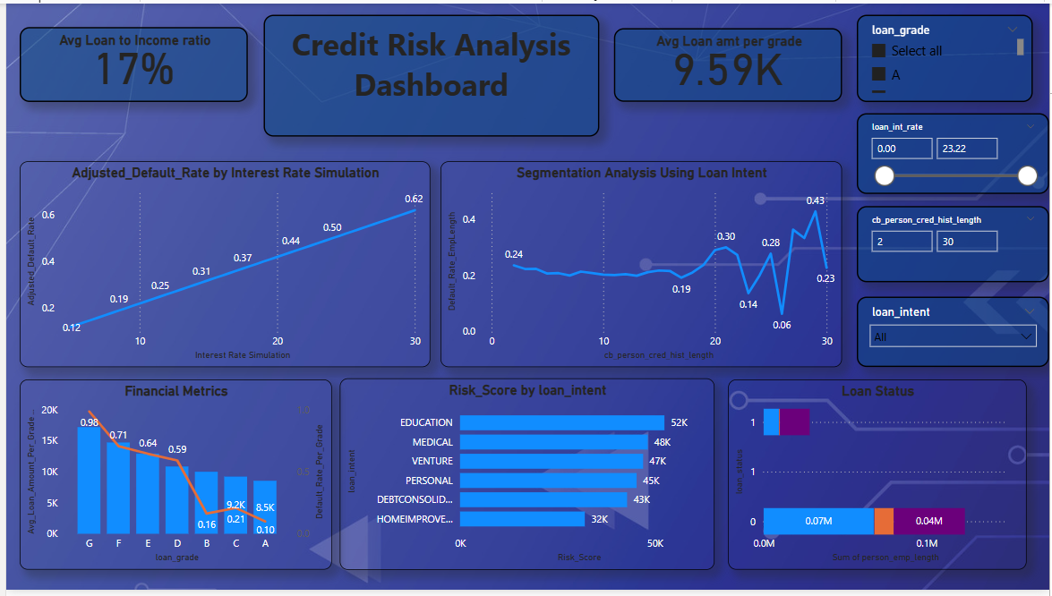
DASHBOARD
Explore new technologies, market trends, or disruptive forces that could shape the future competitive landscape. Understanding these trends helps you anticipate potential threats and opportunities.

Slide 12
THANK YOU

